Slide 1

Effect of Diseases on Life Expectancy in Zimbabwe
Notes:
My Name is Mahmoud, Data Visualization Designer for the effect of diseases like HIV and Hepatitis B on Life Expectancy in Zimbabwe between 2000 to 2015 will be shared with you, the Health Minister for Zimbabwe. I’m going to ask you two questions, Why Life Expectancy in Zimbabwe was low and over time became high? Do you think HIV rate affected Life expectancy? Do you think Hepatits B has an effect on Life expectancy?

Slide 2
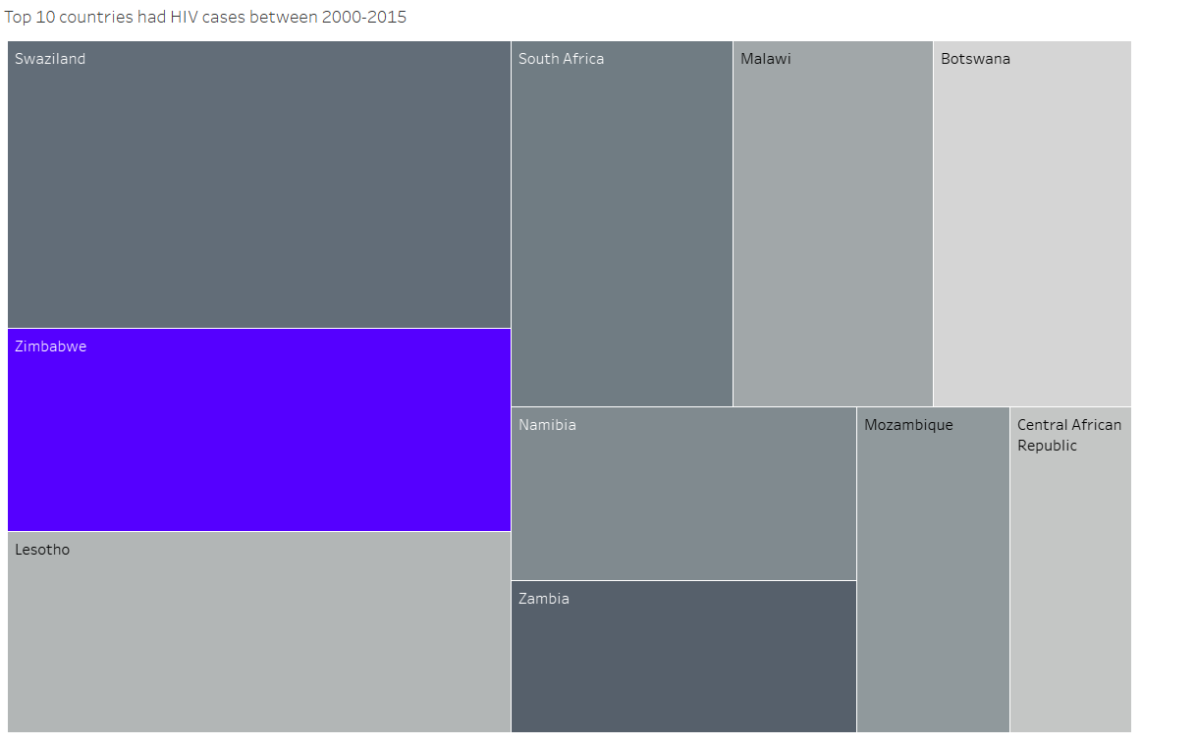
Countries have the highest HIV cases
Notes:
on this chart, the countries that have the highest HIV cases are Swaziland, Zimbabwe, Lesotho, South Africa, Namibia, Zambia, Malawi, Mozambique, Botswana, and the Central African Republic As we see most HIV countries are from Africa because of poor and lake of health facilities. That’s why I chose Zimbabwe the second-highest country in the world and the first African country that had HIV cases between 2000-2015. Zimbabwe has average HIV cases 23 cases between 2000-2015

Slide 3
Increasing HIV cases in Zimbabwe
.Early HIV screening by the National Blood Transfusion Services (BTS) indicated that HIV prevalence was 2–3% among blood donors (Mahomva et al., 2006).
The rate of annual new HIV infections among adults in Zimbabwe is approximately 31,000 persons over a year. (Zimbabwe, 2022b).
Notes:
- The HIV epidemic in Zimbabwe Started 1980s and reached a peak in the 1990s then went down in the 2000s because of HIV vaccination and health awareness. The survey found that HIV prevalence was higher among women than men (Zimbabwe, 2022b).

Slide 4
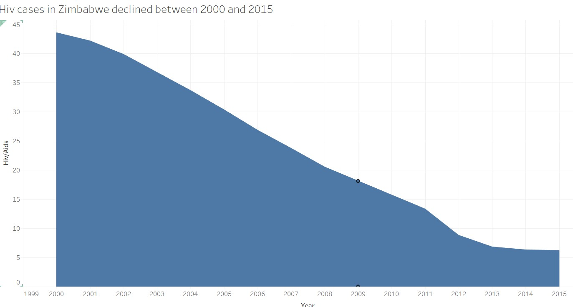
HIV cases declined in Zimbabwe
Notes:
This chart shows the decline in HIV cases and the two main reasons that can explain reductions in new HIV infections in generalized HIV epidemics:
1) Natural dynamics: if the groups at higher risk are already infected or have died
2) Behavior change: significant changes in sexual behavior.

Slide 5
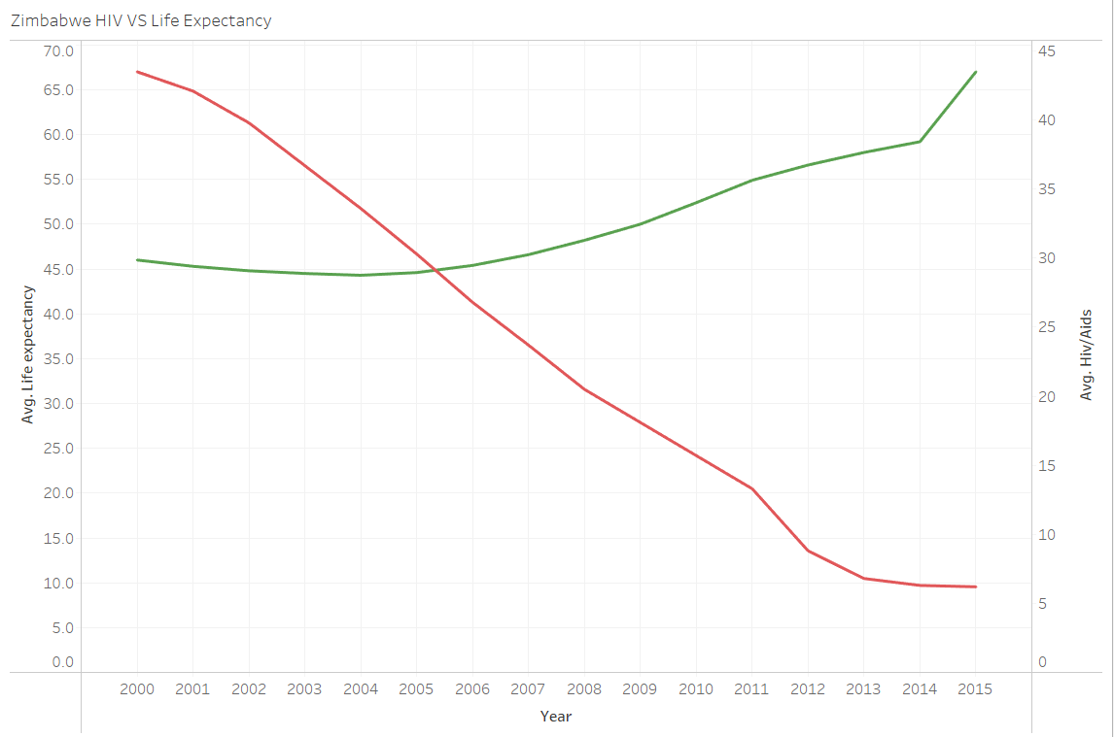
Zimbabwe HIV vs Life Expectancy
Notes:
This chart shows that Life Expectancy(green line) increased when the HIV rate decreased(red line).
When the pandemic started, the life expectancy rate was low then gradually raised,
AVG Life Expectancy went up from 46 age in 2000 to 67 age in 2015

Slide 6
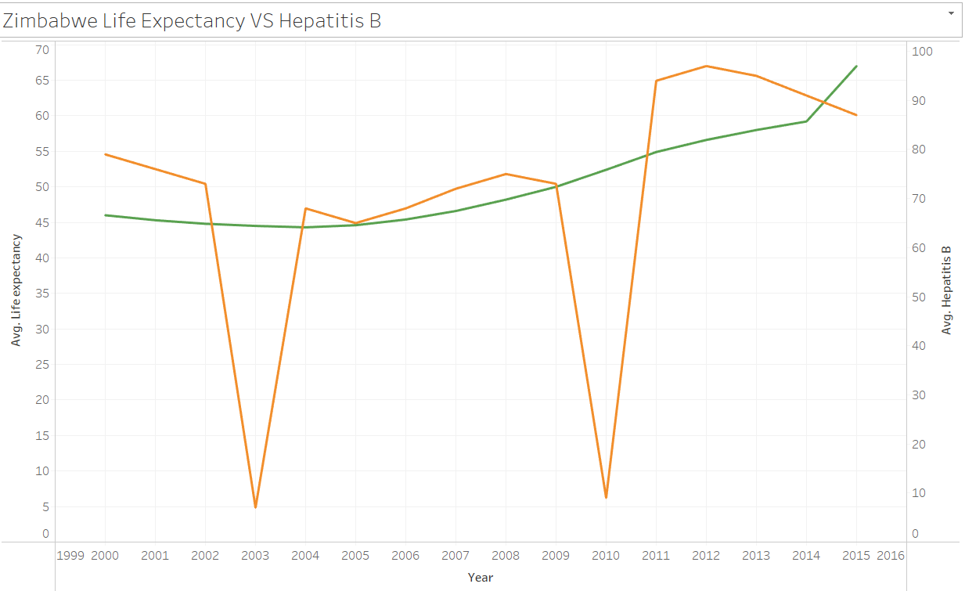
Hepatitis B vs Life Expectancy
Notes:
In this chart, as we see Hepatitis B (Orange line) fluctuates, however, the Life Expectancy (green Line) enhanced slowly which means Hepatitis B has a direct effect on Life expectancy in Zimbabwe

Slide 7
Recommendations to Health Minister
Health Awareness Programs
Free HIV and Hepatitis B vaccination
Free Screening
Periodic testing
Notes:
I have some recommendations for the Zimbabe Health Minister to reduce HIV and HBV cases
1-Health awareness campaigns everywhere like in Media, on the streets, and in hospitals.
2-Free HIV and HBV vaccination for infected and non-infected patients.
3-Free Screening and periodic testing every 1 year so we can fight diseases in their early stages.

Slide 8
Conclusion
Impact of HIV on Life Expectancy in Zimbabwe (2000-2015)
Epidemic Management is important to control the disease from spreading
Notes:
To Sum up, these findings highlight the critical relationship between public health interventions, societal behavior shifts, and life expectancy. Epidemic management is important to control the diseases from spreading in the early stages.

Slide 9
References
Mahomva, A., Greby, S., Dube, S., Mugurungi, O., Hargrove, J., Rosen, D., Dehne, K., Gregson, S., St Louis, M., & Hader, S. (2006). HIV prevalence and trends from data in Zimbabwe, 1997-2004. Sexually Transmitted Infections, 82(suppl_1), i42–i47. https://doi.org/10.1136/sti.2005.019174
Zimbabwe, U. E. I. (2022b, March 14). National HIV Survey (ZIMPHIA 2020) Results Indicate Zimbabwe is On Track to Achieve HIV Epidemic Control by 2030 - U.S. Embassy in Zimbabwe. U.S. Embassy in Zimbabwe. https://zw.usembassy.gov/national-hiv-survey-zimphia-2020-results-indicate-zimbabwe-is-on-track-to-achieve-hiv-epidemic-control-by-2030/#:~:text=According%20to%20the%20survey%2C%20the,10.2%20percent).

Slide 10
Thank you

